Slide 1
DevOps Concepts

Slide 2
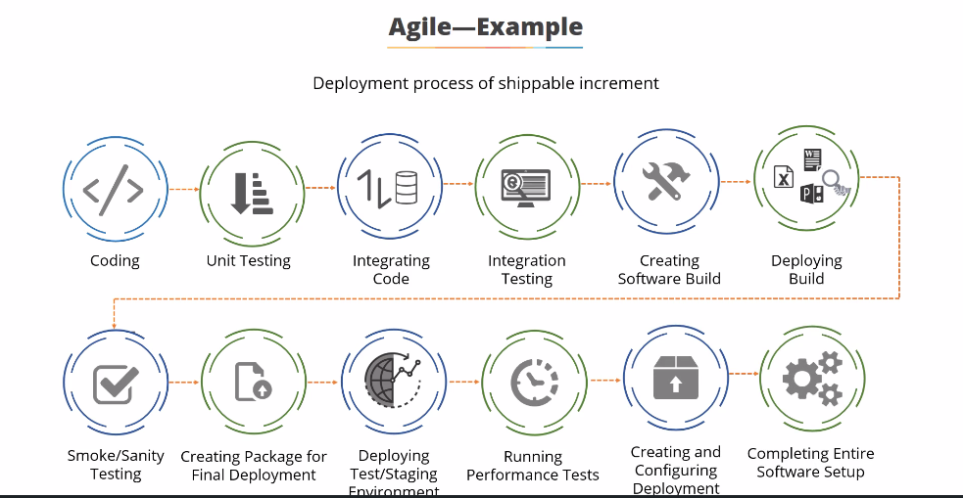

Slide 3
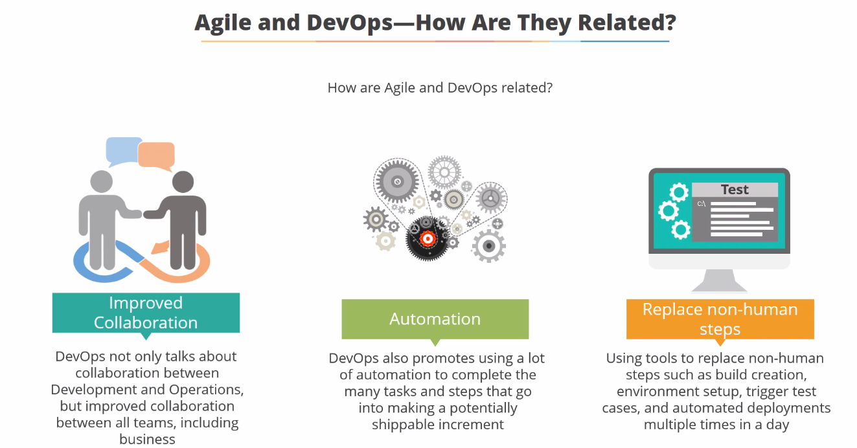

Slide 4
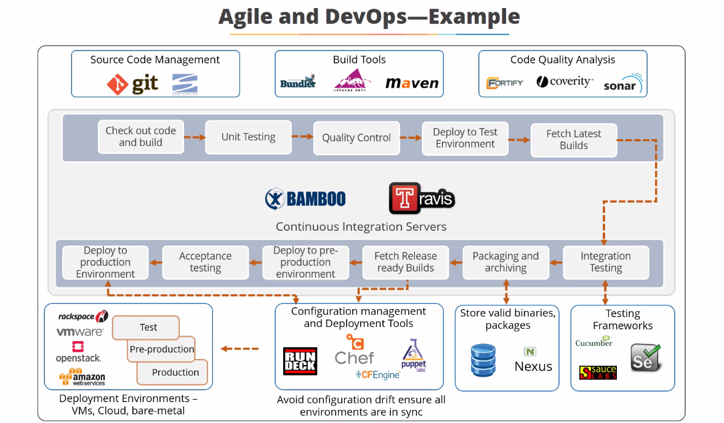

Slide 5
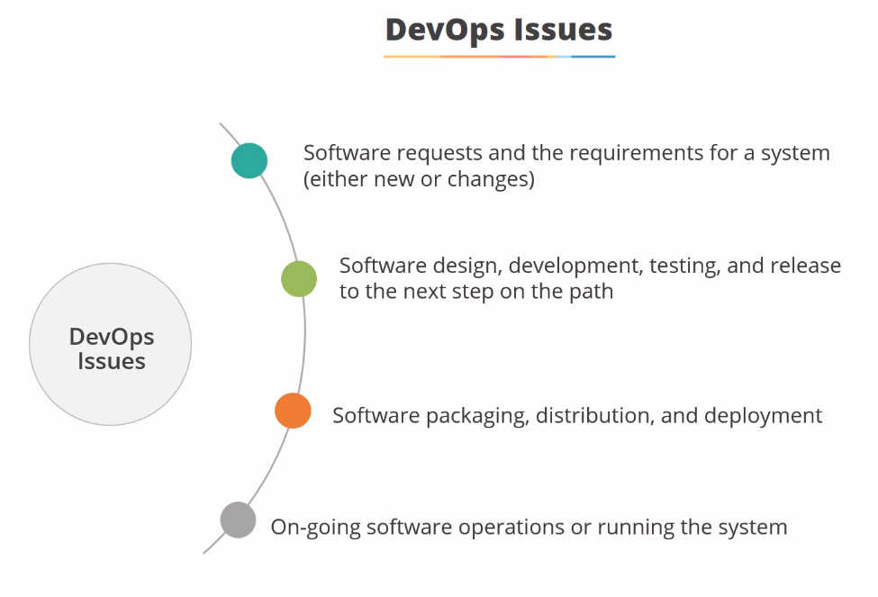

Slide 6
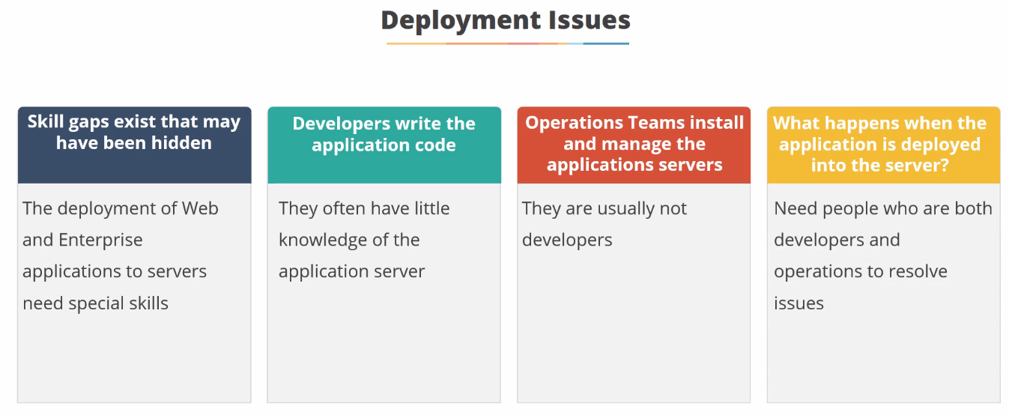

Slide 7
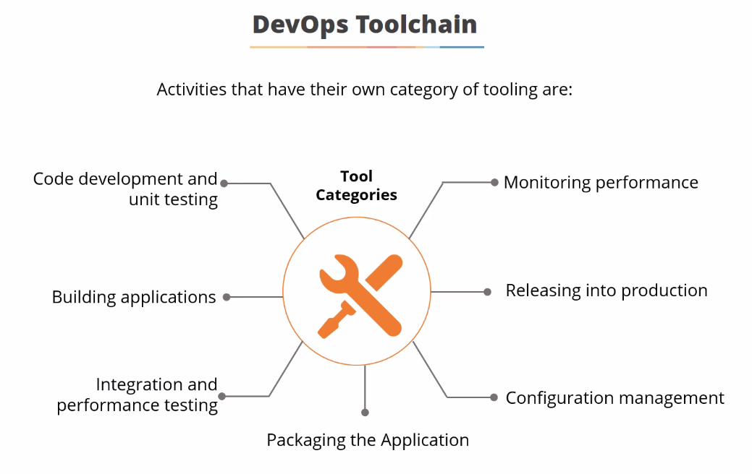

Slide 8
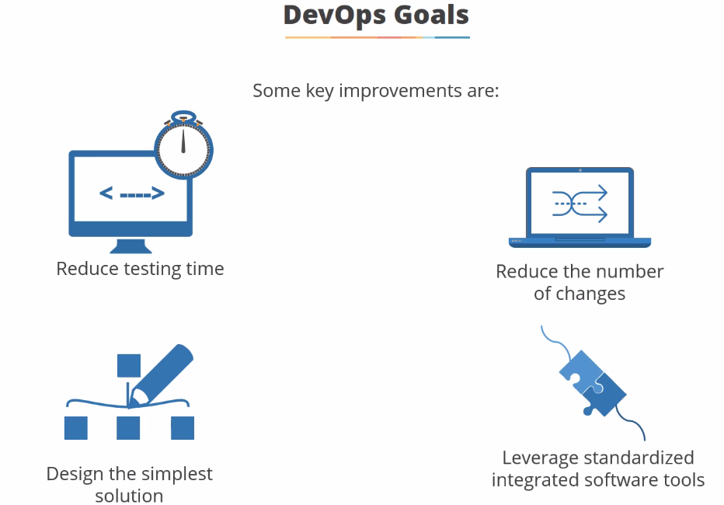

Slide 9
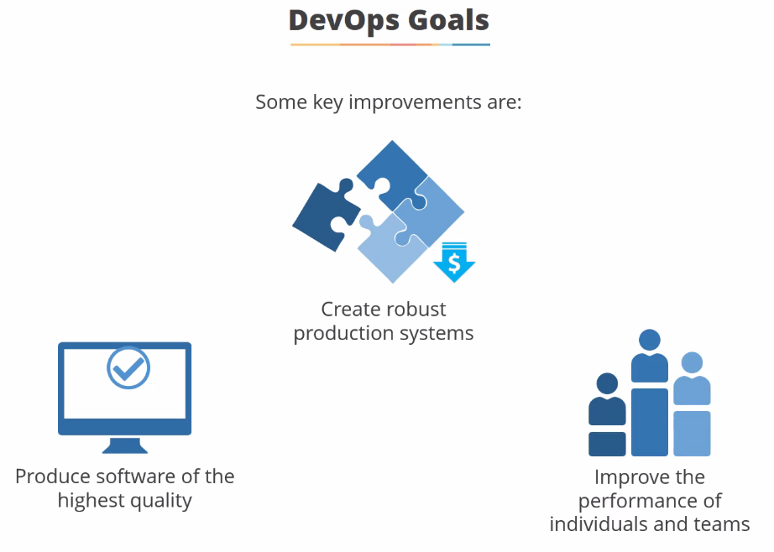

Slide 10
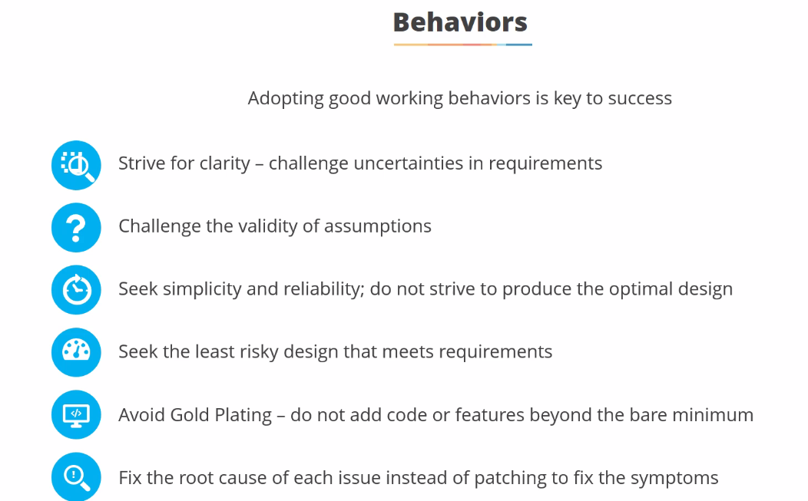

Slide 11
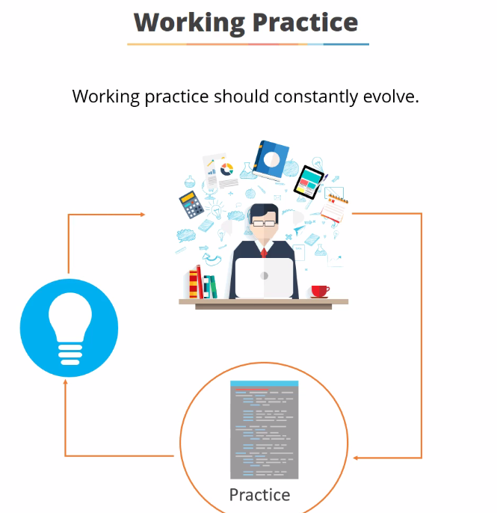

Slide 12
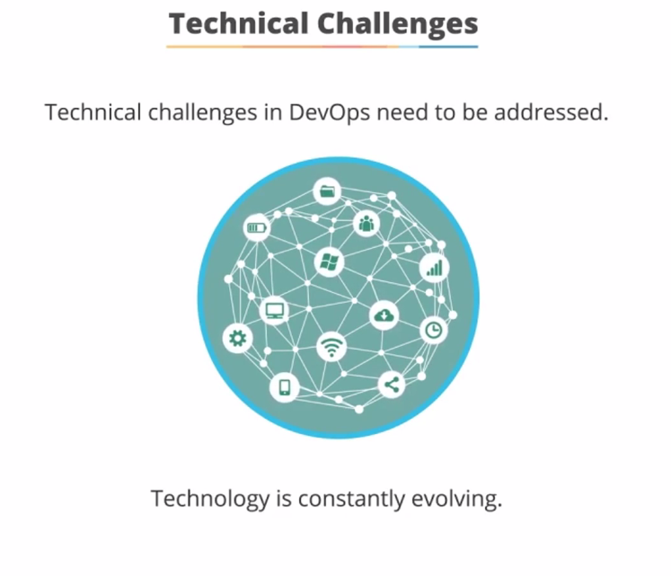

Slide 13
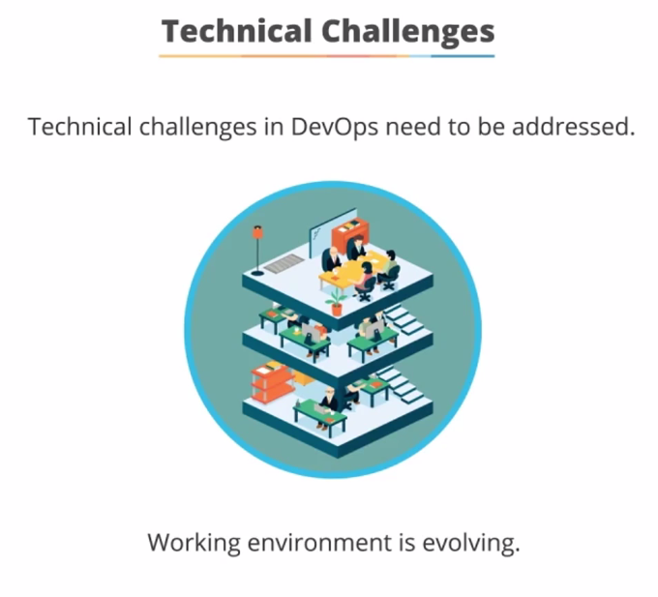

Slide 14
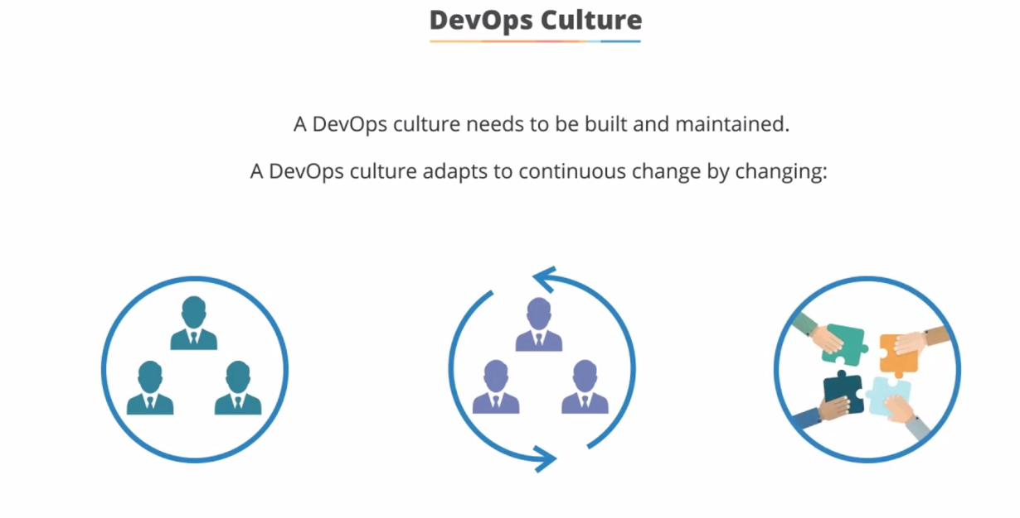

Slide 15
Software Tools

Slide 16
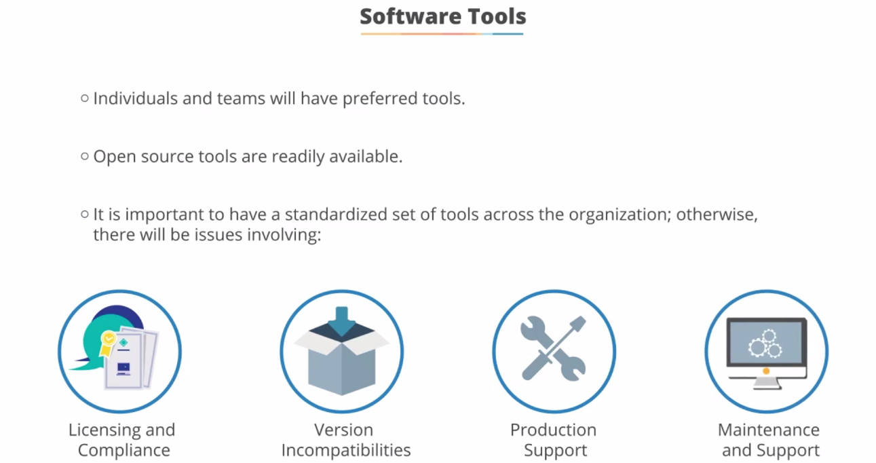

Slide 17
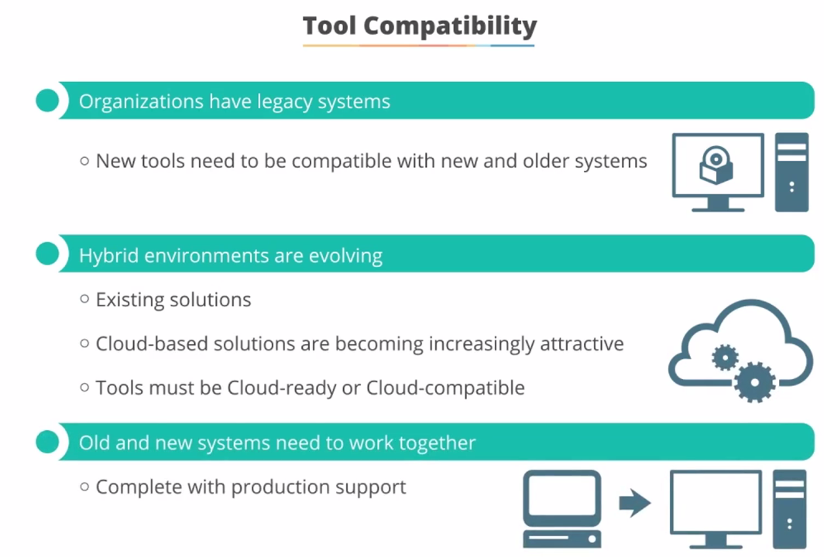

Slide 18
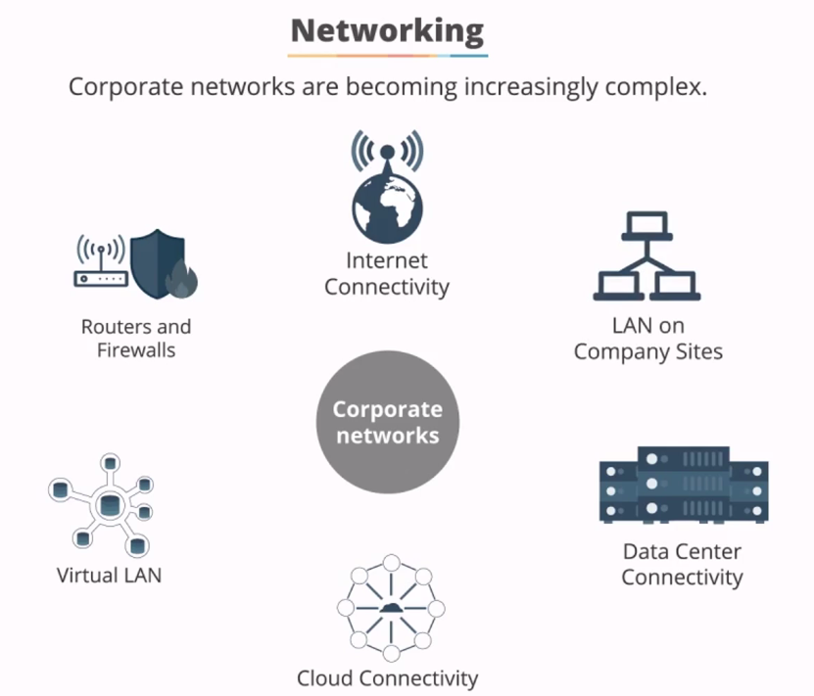

Slide 19
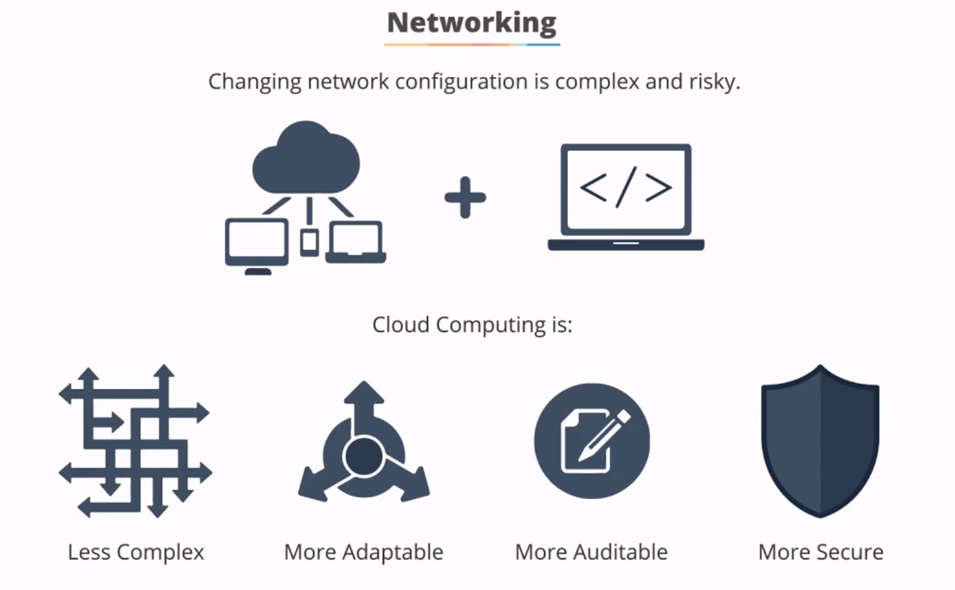

Slide 20
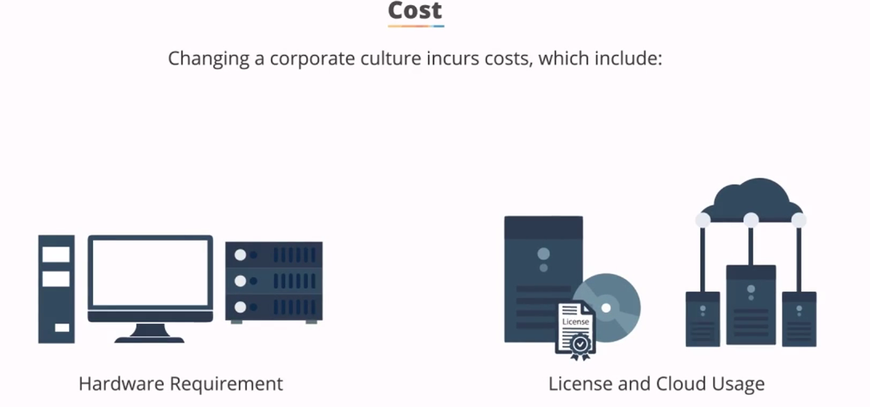

Slide 21
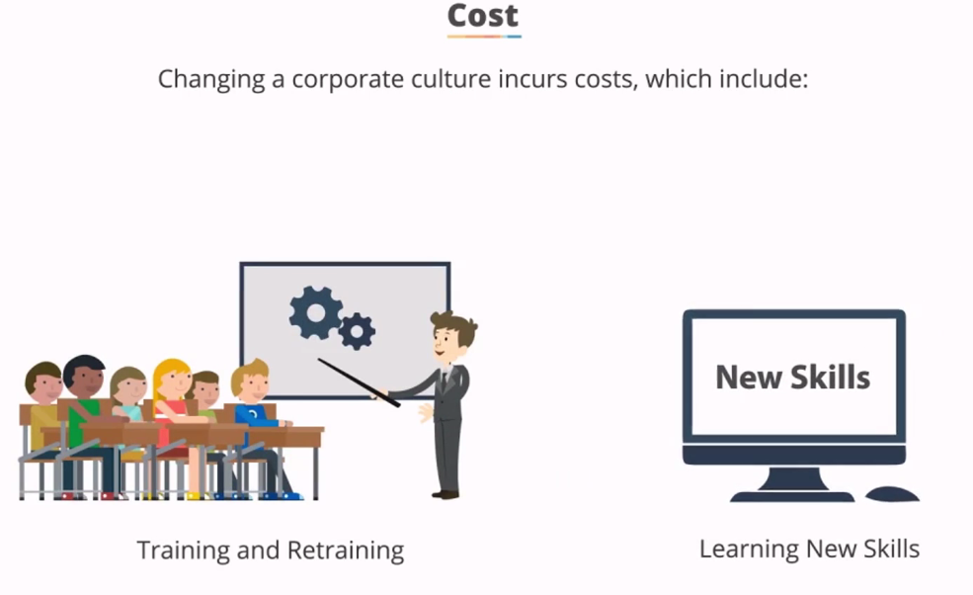

Slide 22
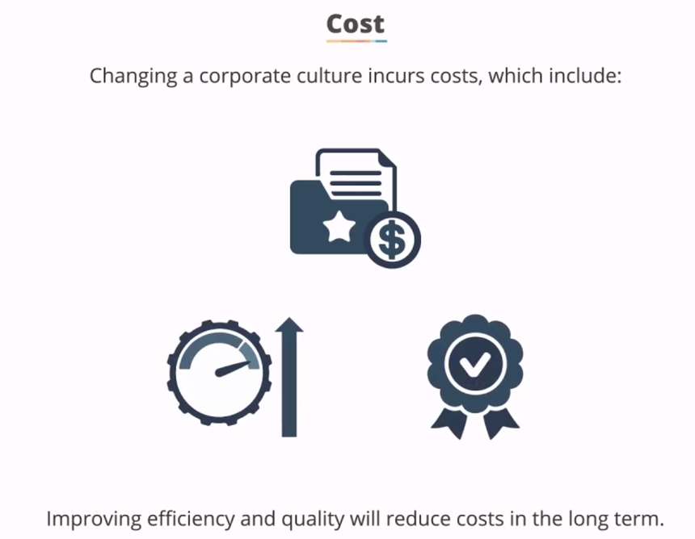

Slide 23
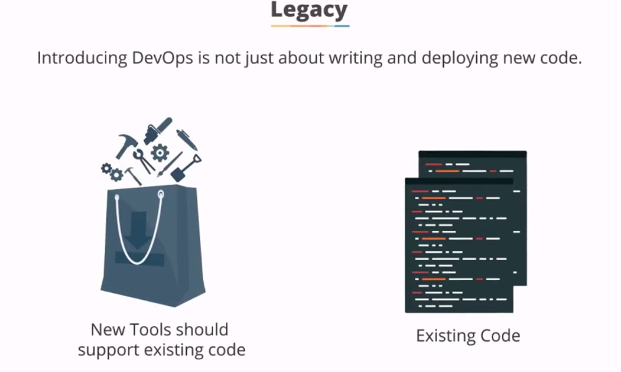

Slide 24
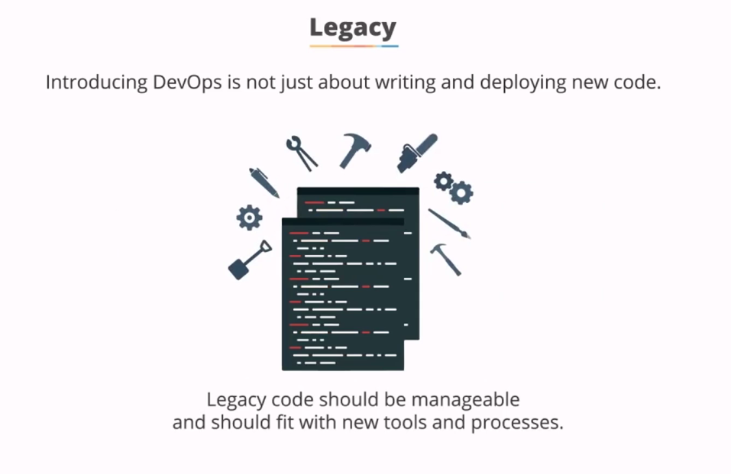

Slide 25


Slide 26
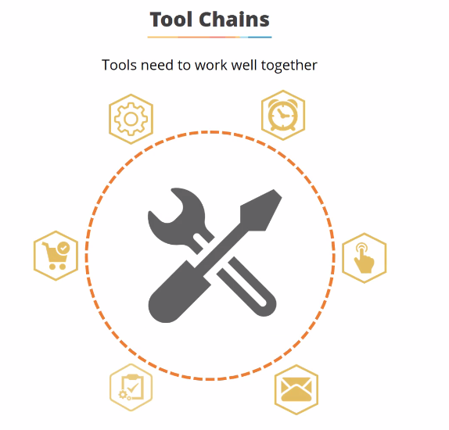

Slide 27
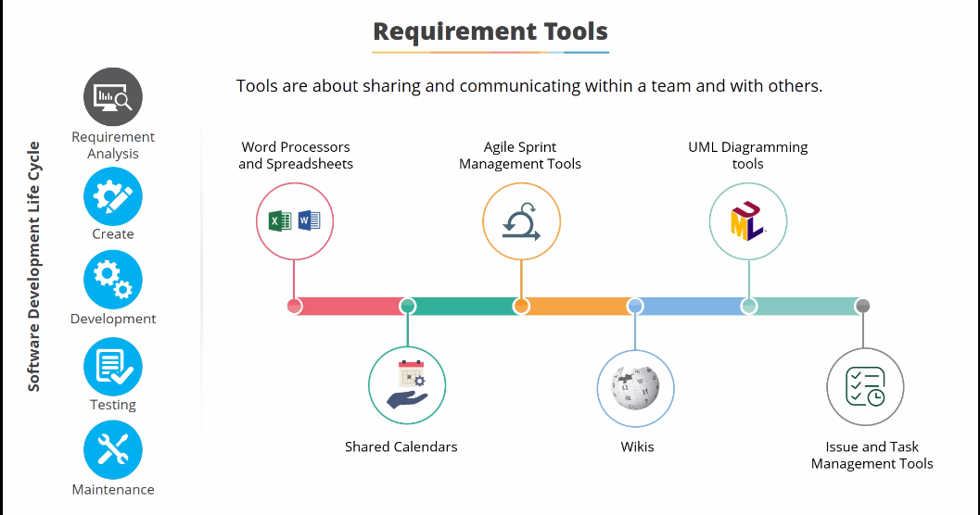

Slide 28
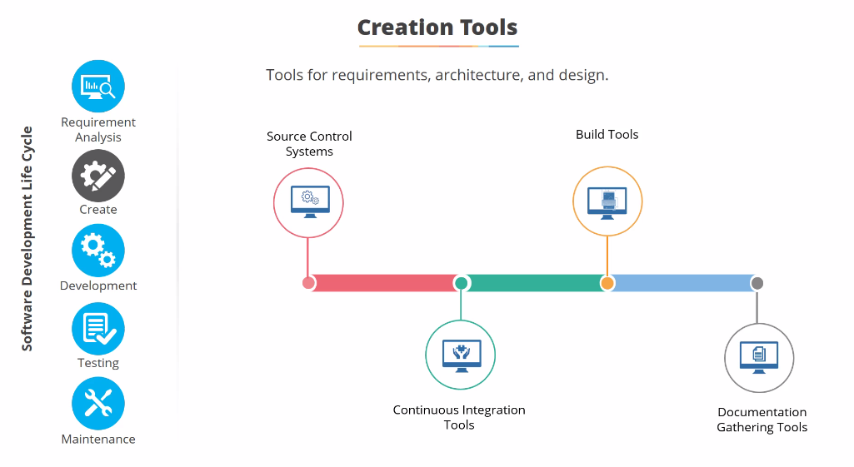

Slide 29
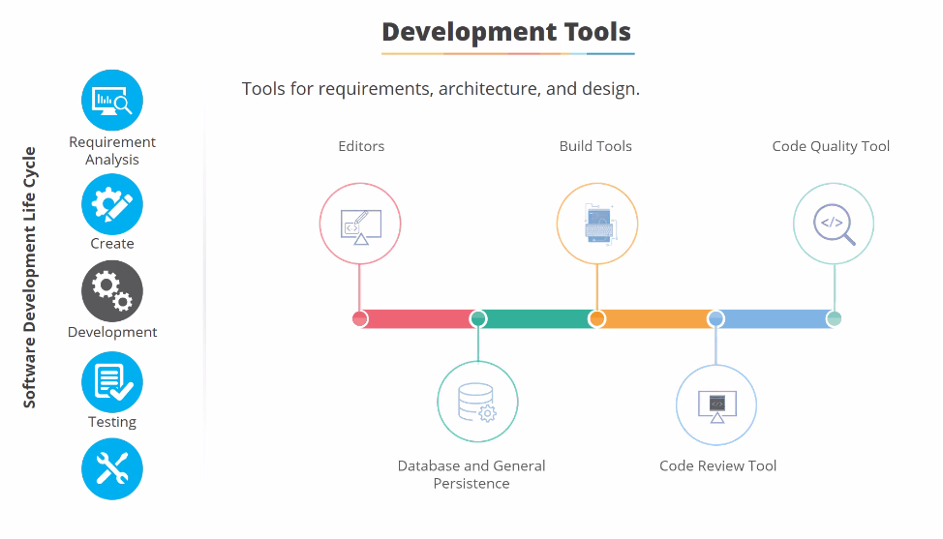

Slide 30
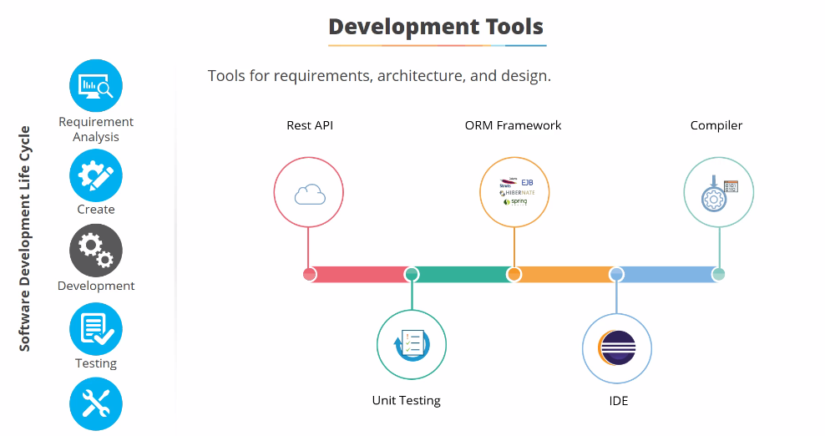

Slide 31
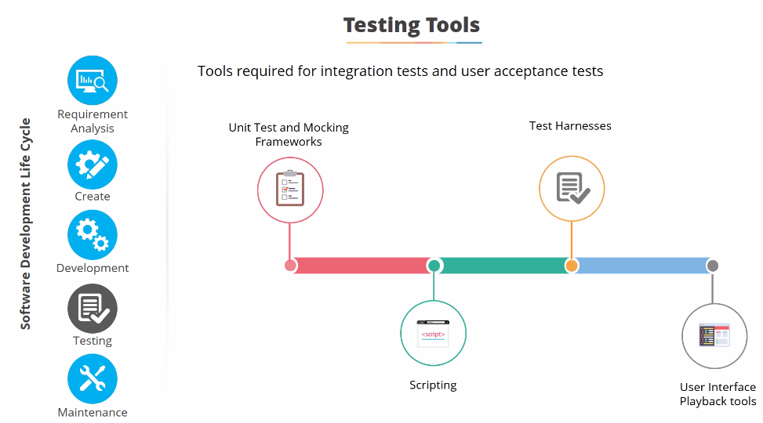

Slide 32
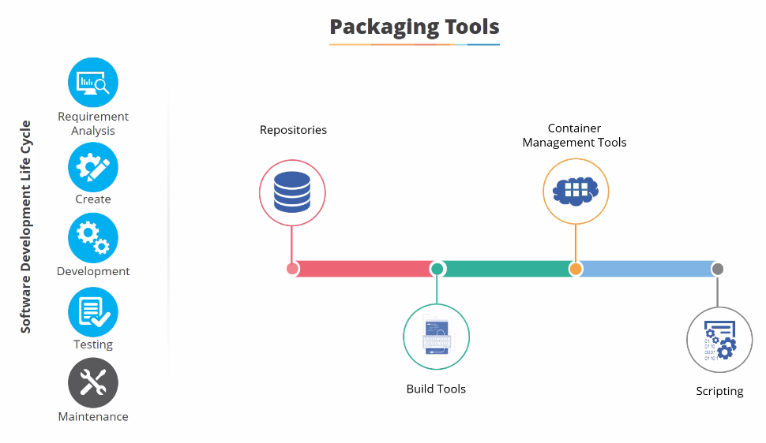

Slide 33
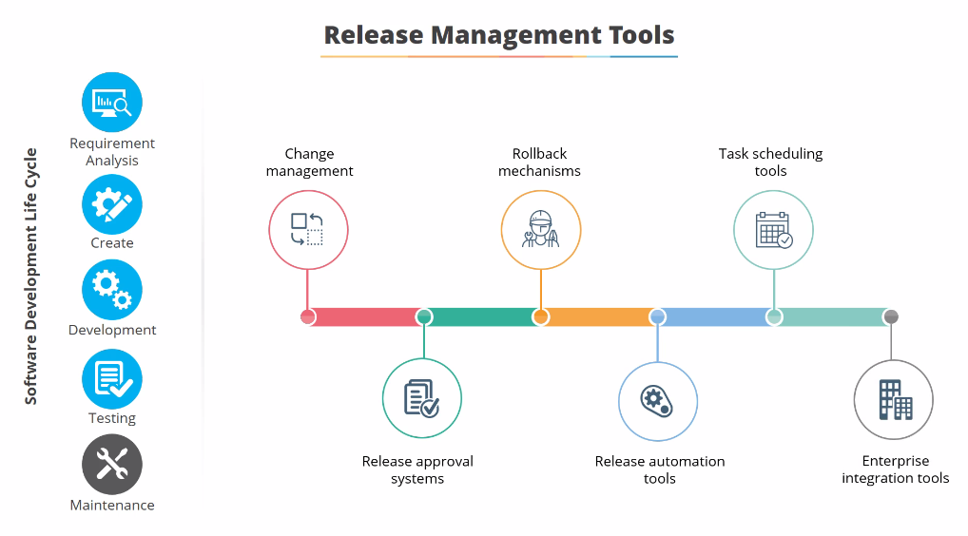

Slide 34
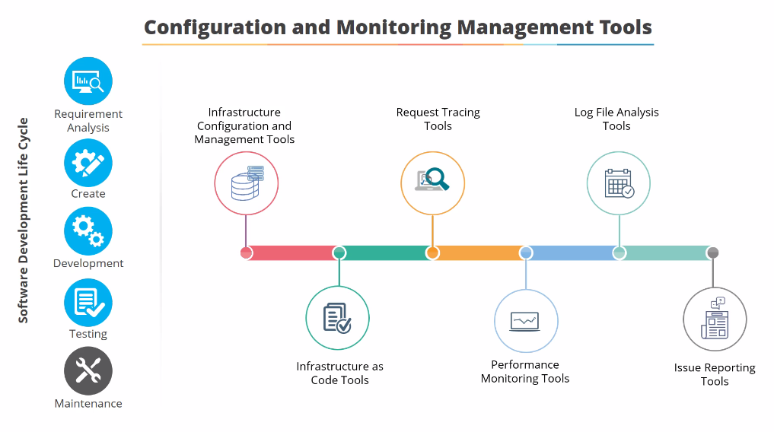

Slide 35
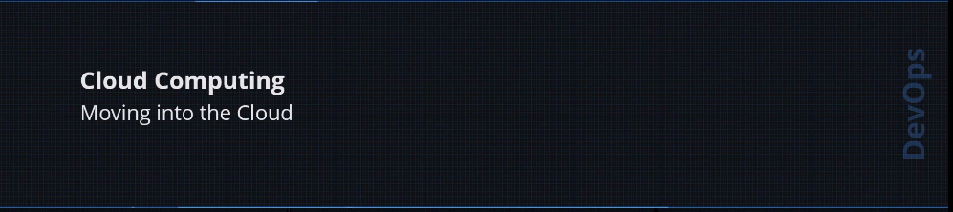

Slide 36
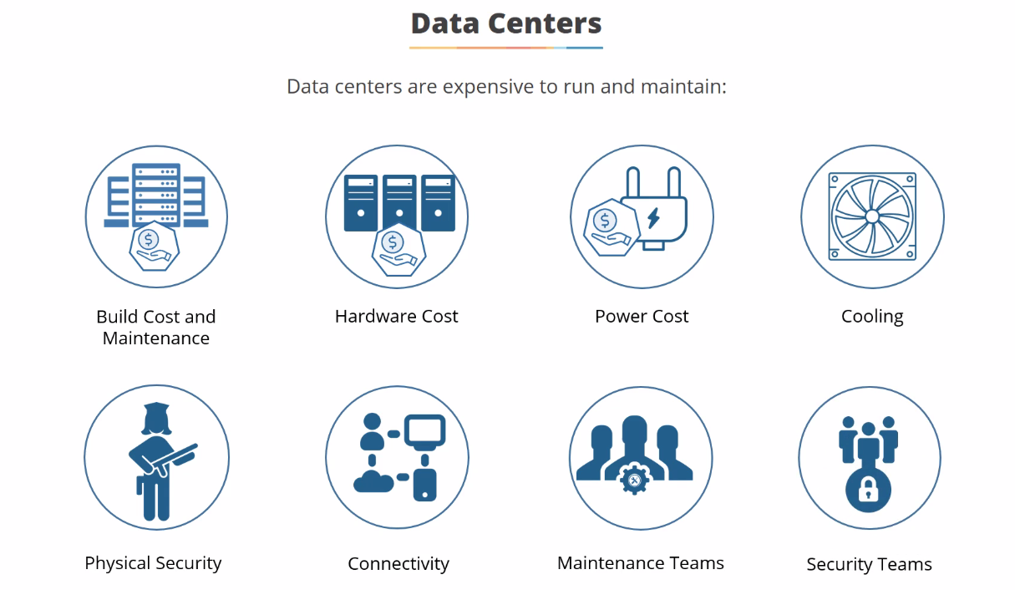

Slide 37
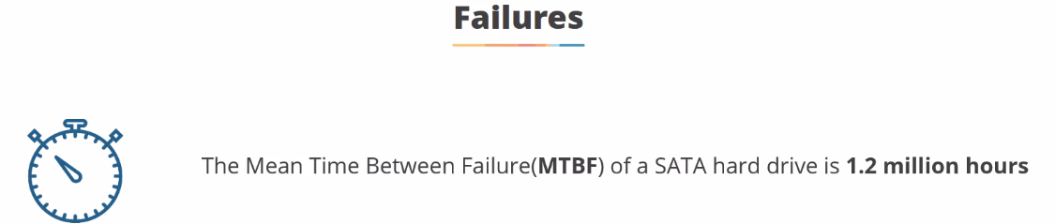
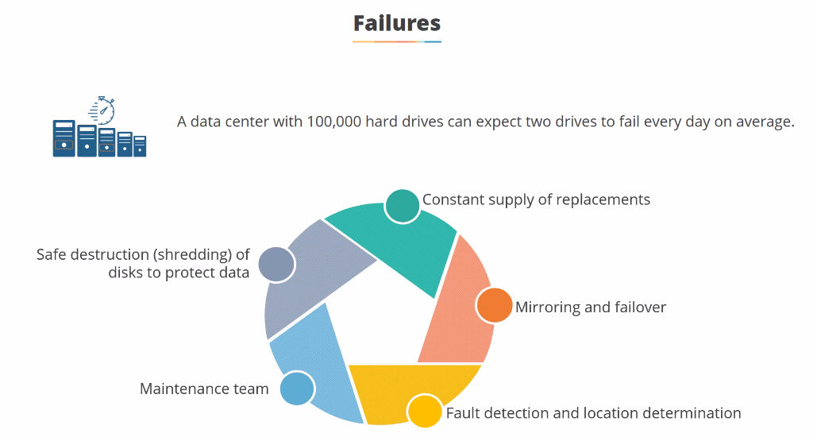

Slide 38
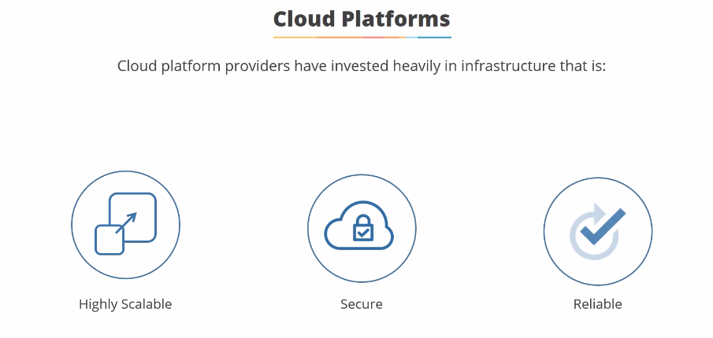

Slide 39
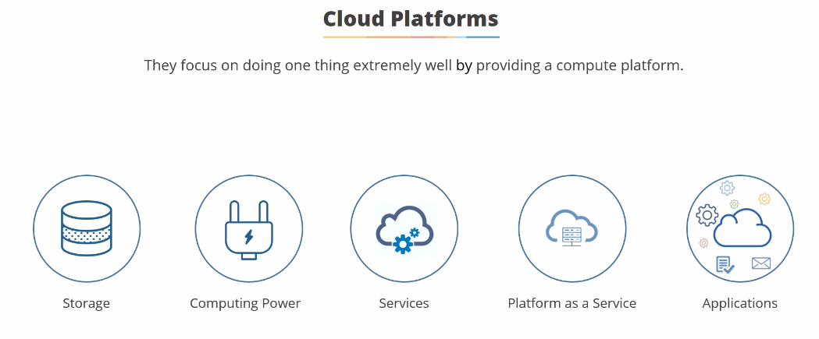

Slide 40
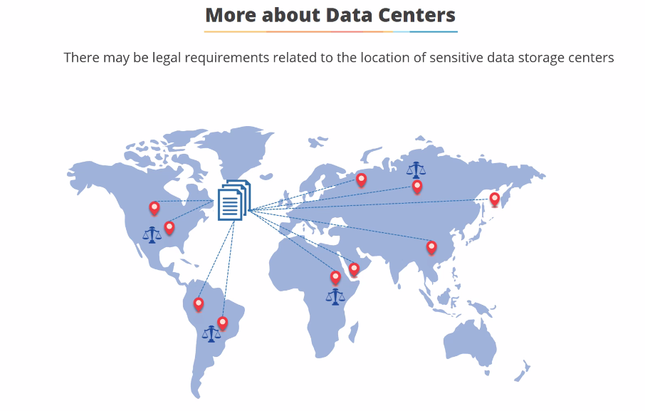

Slide 41
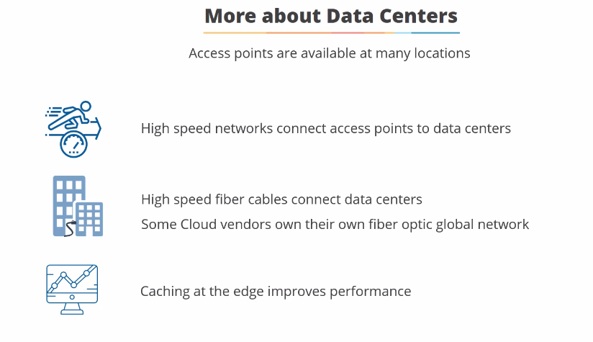

Slide 42
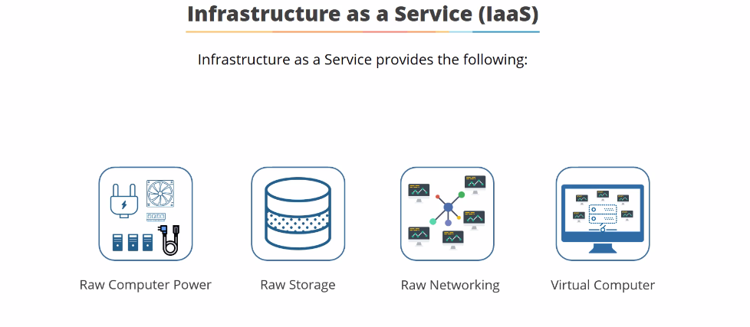

Slide 43
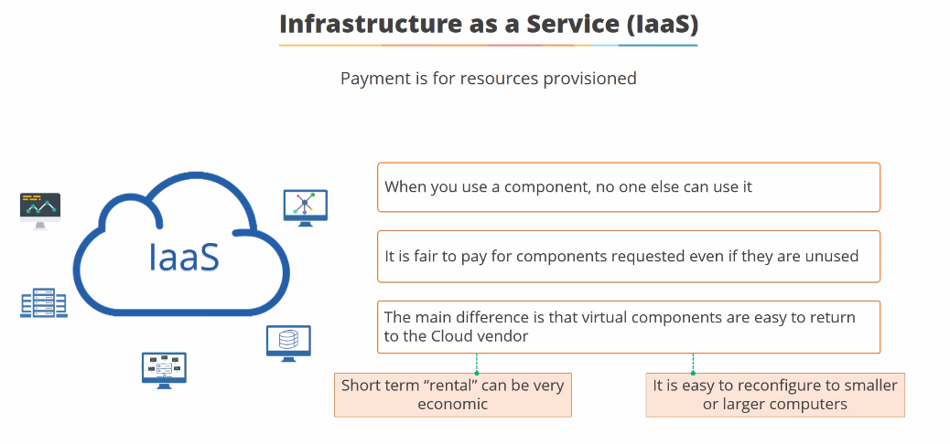

Slide 44
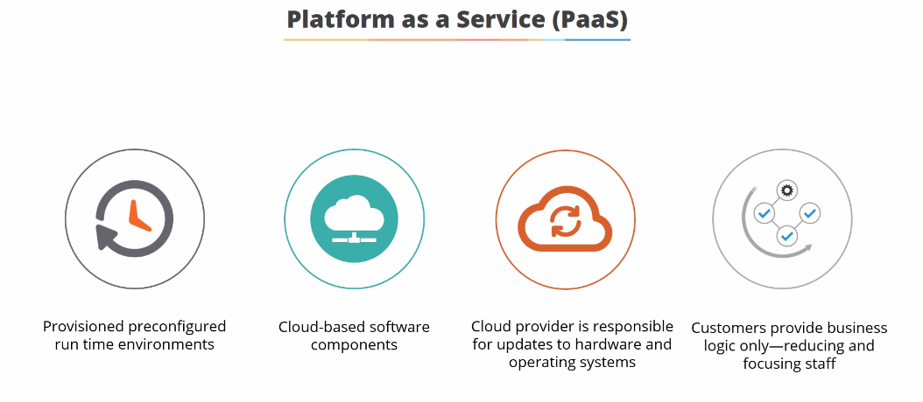

Slide 45
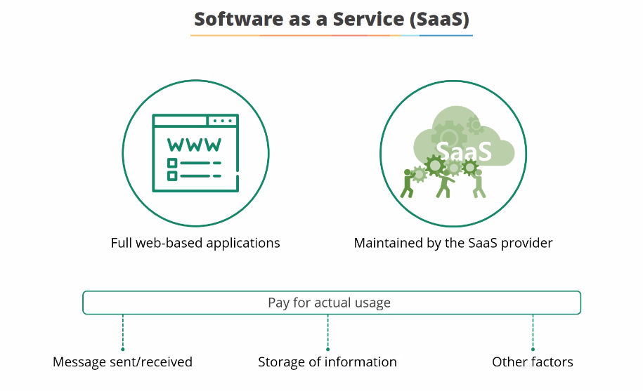

Slide 46
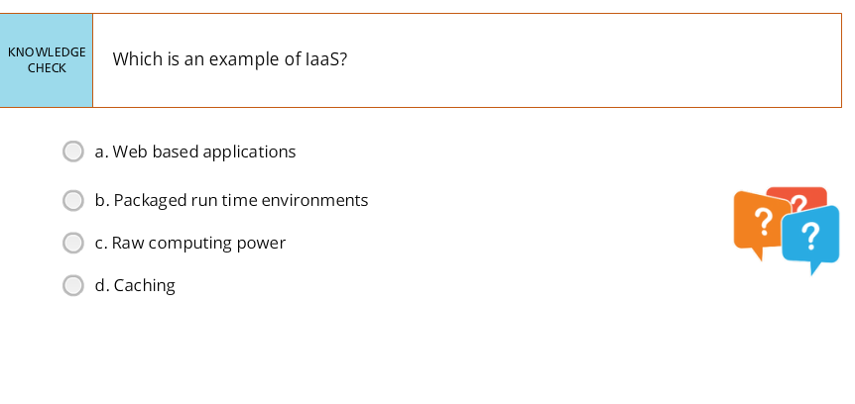
Notes:
C

Slide 47
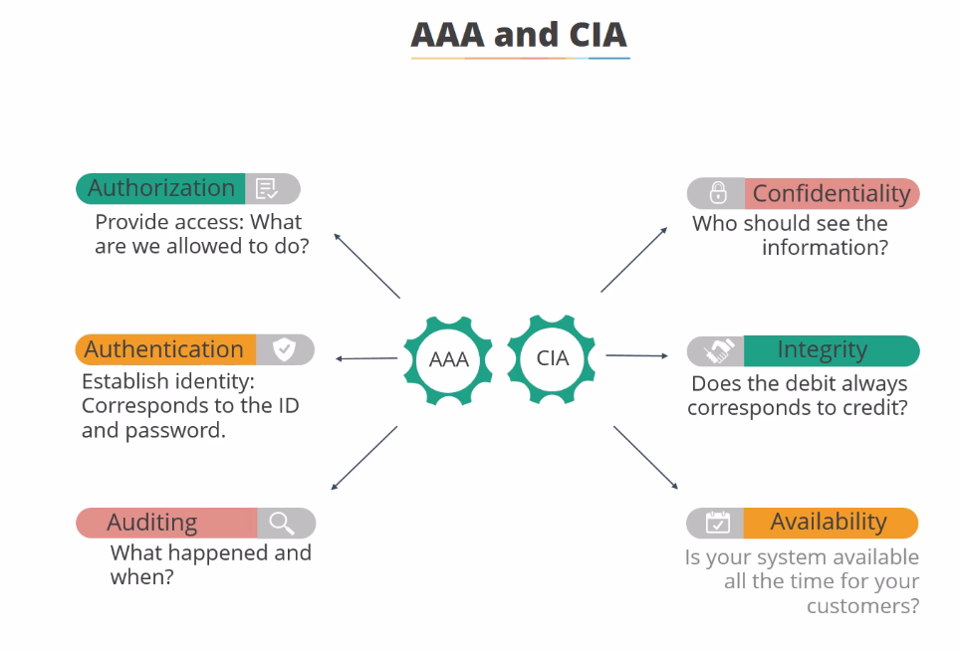

Slide 48
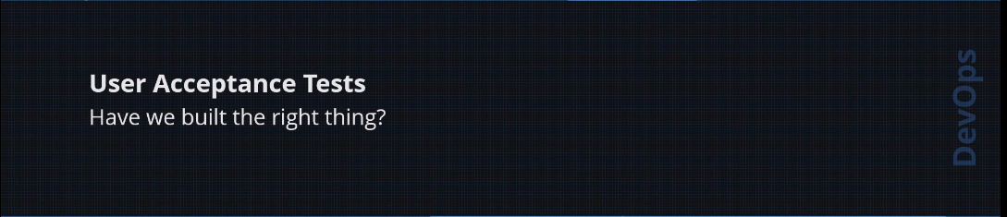

Slide 49
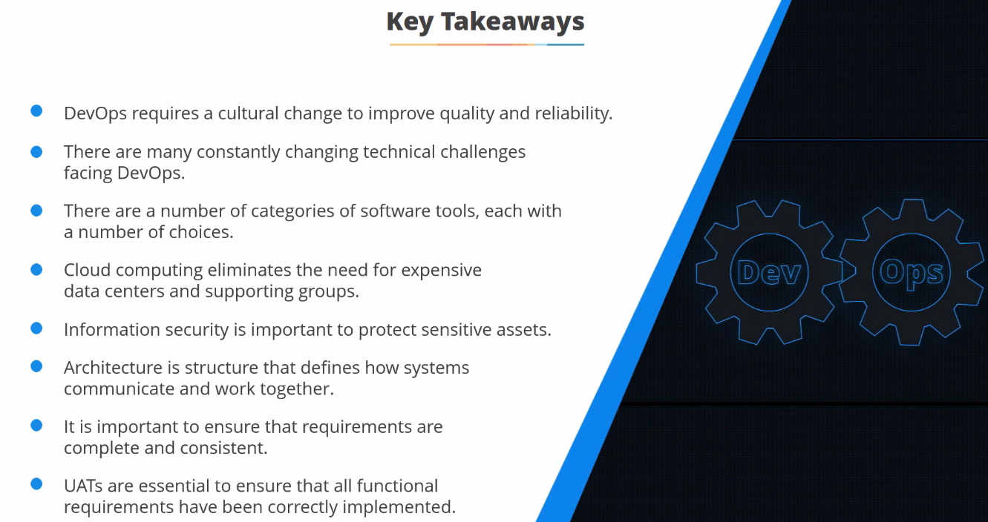

Slide 50


Slide 51
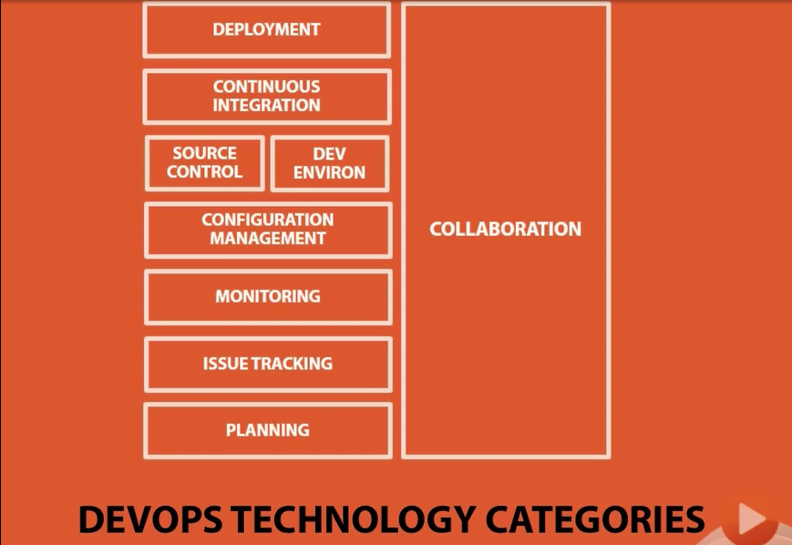
Notes:
Collaboration: All the teams are communicating regularly with meaningful information where it’s Agile stand up.
How do you encouraging collaboration : Rapid communication so that people can make a decision
Tools can help in doing it technically but need to have the interest of collaborating.
Collaboration eliminates the waiting waste which would be a devops success
Skpye / Slack
How easily / quickly I get

Slide 52
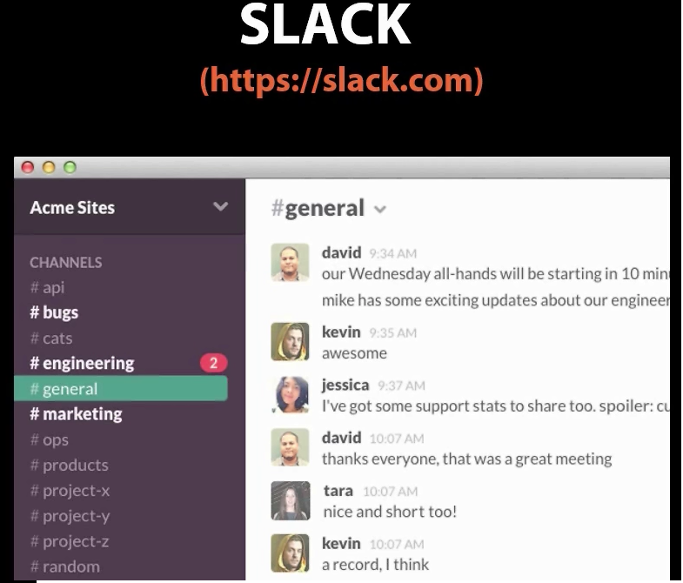

Slide 53
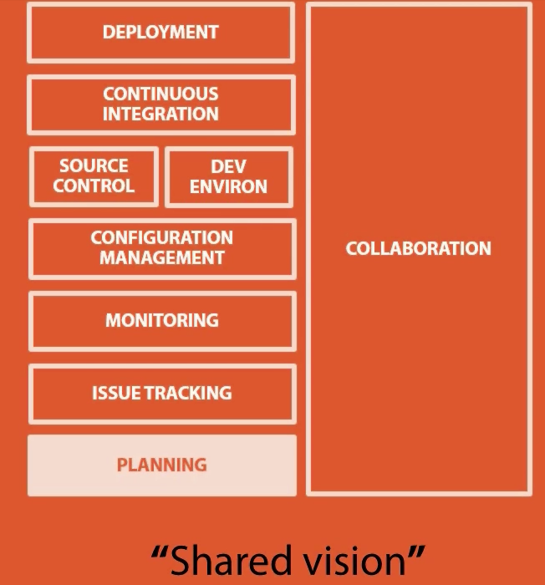
Notes:
Planning :
Transparency of communication / team members on what are theys guyz working on
What is the high priority list
What is captured after the event as action items
Feature release meetings 1s a week
Shared vision on the customer requirement

Slide 54

Notes:
Planning with collaboration

Slide 55

Notes:
How am I doing things in a single way to collect the issues & respond to it.
Copying multiple times the defects with multiple tools- stop going that – Transpiration waste / Motion waste
Information might get degrade when it travel between the system
Have a shared way to collect the view & see whats going on / close all the loop is the best way

Slide 56


Slide 57

Notes:
Developer will be doing the coding with customers in mind & Operations should consider to add the developers when there is an issue / alert
Uptime, Service check

Slide 58


Slide 59



Slide 60

Notes:
Monitoring tools

Slide 61


